Slide 1
WORKSHOP Machine Learning
Created by : Sofian fadli, s.t.

Slide 2
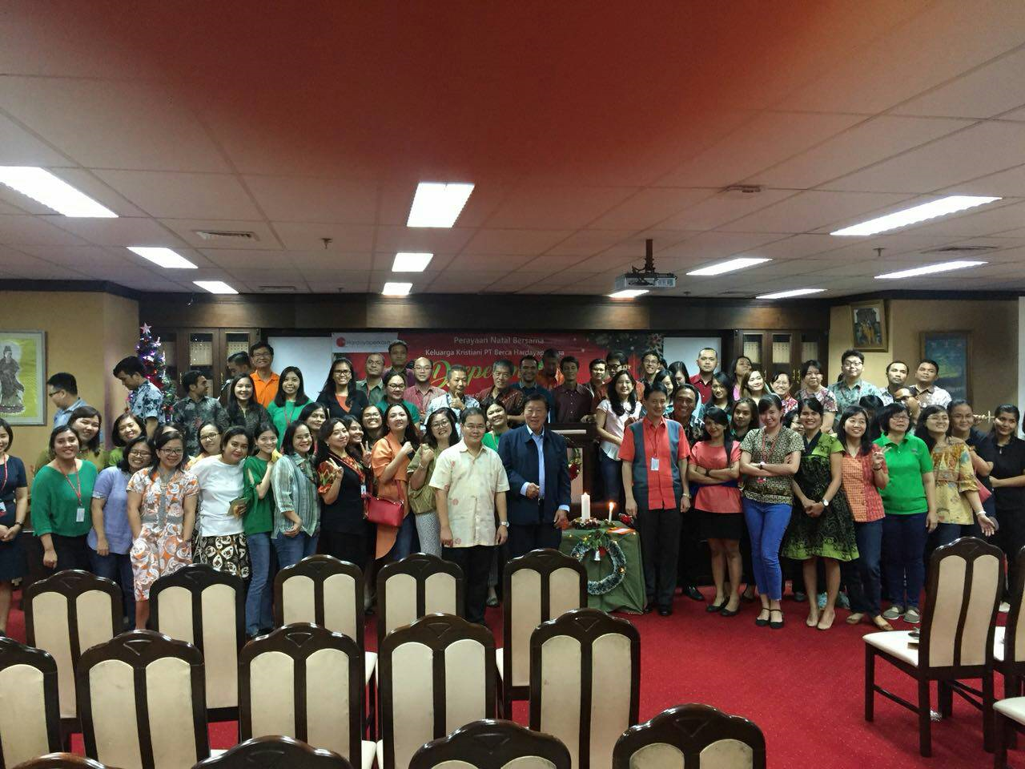



Posisi :
- Technical Consultant utk divisi BI (Business Intelligence)
Project :
Migrasi Data di Timezone menggunakan Pentaho
Project OBD II Reader menggunakan Raspberry PI dan Platform IoT KAA
Project Sentiment Analysis untuk XL Axiata

Slide 3
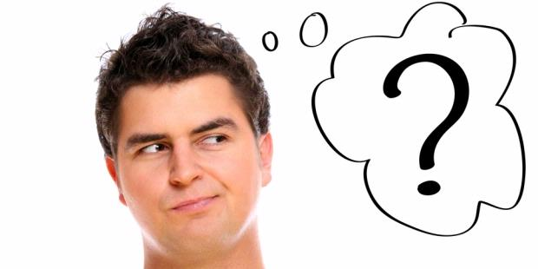
APA ITU MACHINE LEARNING ?

Slide 4


Berdasarkan
Sistem
Mengenali
Berpikir
Memprediksi
Mengambil keputusan

Slide 5
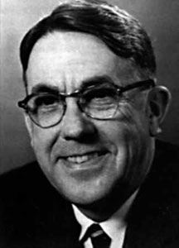
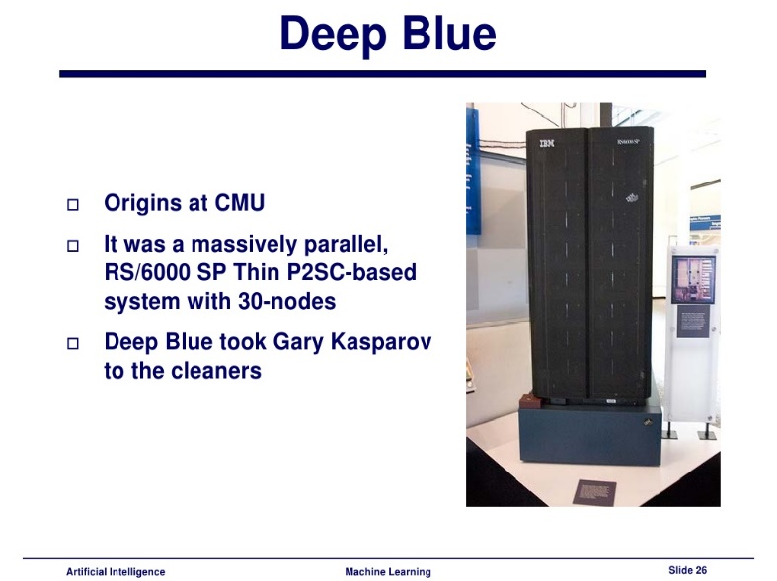
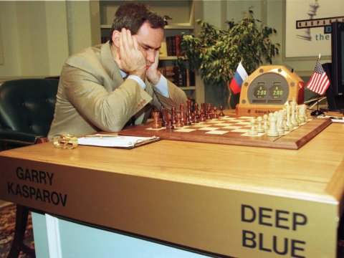
created
Arthur Samuel (thn 1983)
AI Chess Player
Versus
Best Chess Player in the World

Slide 6


Apa Perbedaan ML dengan Programming biasa ?

Slide 7
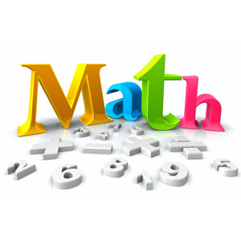
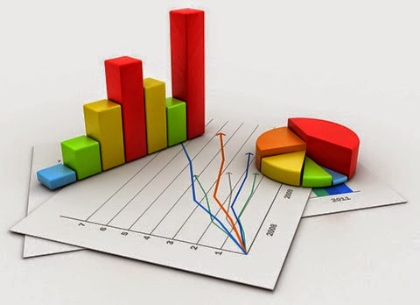
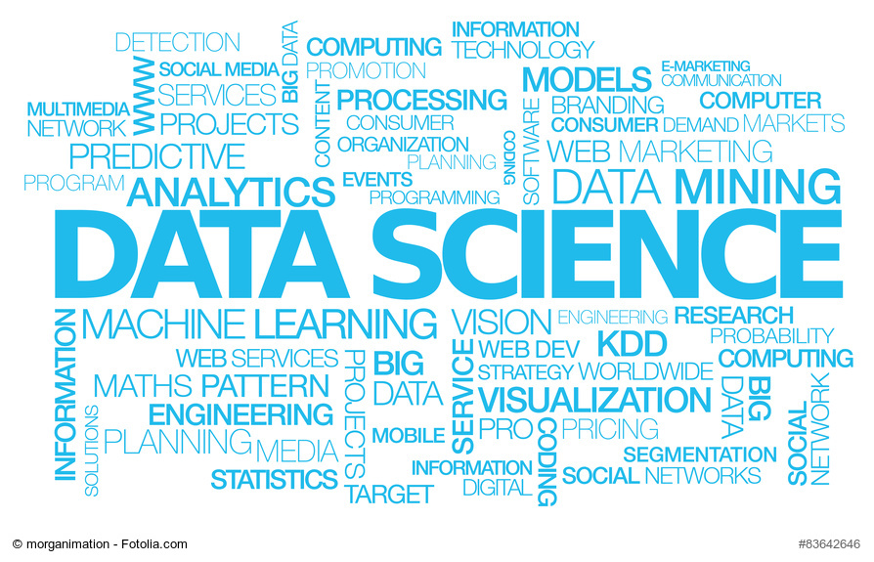



Mathematics
Statistics
Data Science
Programming
Data Mining
Machine Learning

Slide 8
Supervised
Unsupervised
Data diberi label
Data tidak diberi label
Algoritma Pembelajaran
Machine Learning
Output Data
Regresi
Klasifikasi
Analog
Diskrit

Slide 9
Materi
Data Preprocessing
Regression
Classification
Clustering
Association Rule Learning
Reinforcement Learning
Project ML …

Slide 10
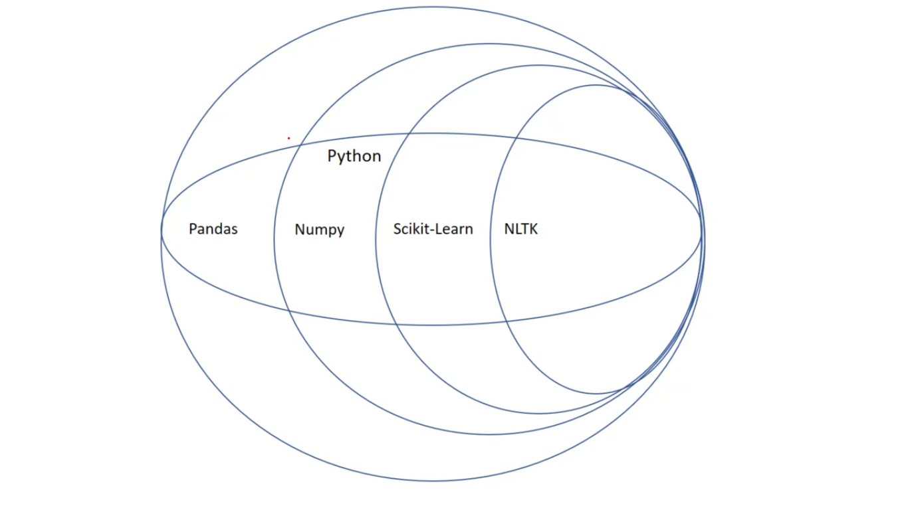
Library Python for ML

Slide 11
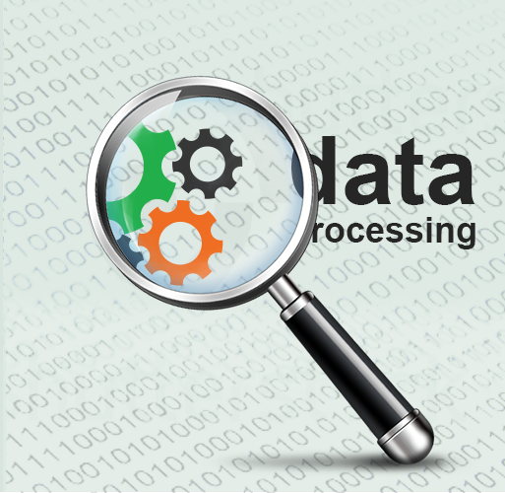
Course - 1
Data preprocessing

Slide 12
Start
A
Get Dataset
Manage Categorical Data
Import Libraries
Splitting Dataset
Import Dataset
Feature Scaling
Diagram Alir
Data Preprocessing
Correct Missing data
Data Preprocessing Template
A
END

Slide 13
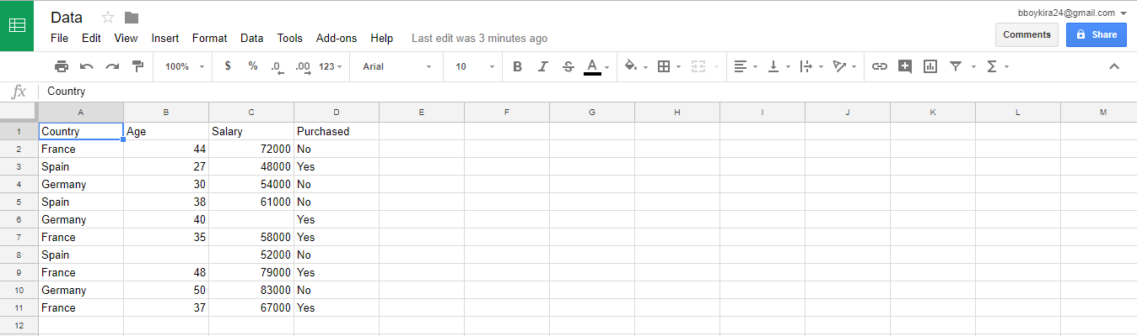
Our Dataset

Slide 14
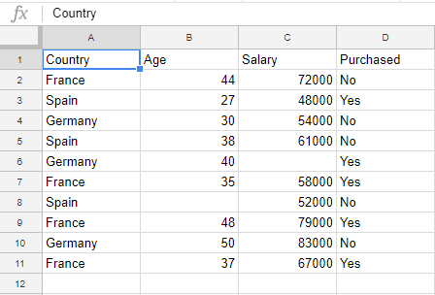
Independent Variables
Dependent Variables

Slide 15
Dataset
.csv
.tsv
Comma Separator Values
Tab Separator Values

Slide 16
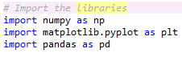
Import the libraries
Mathematics
Plot graph
Manage dataset

Slide 17
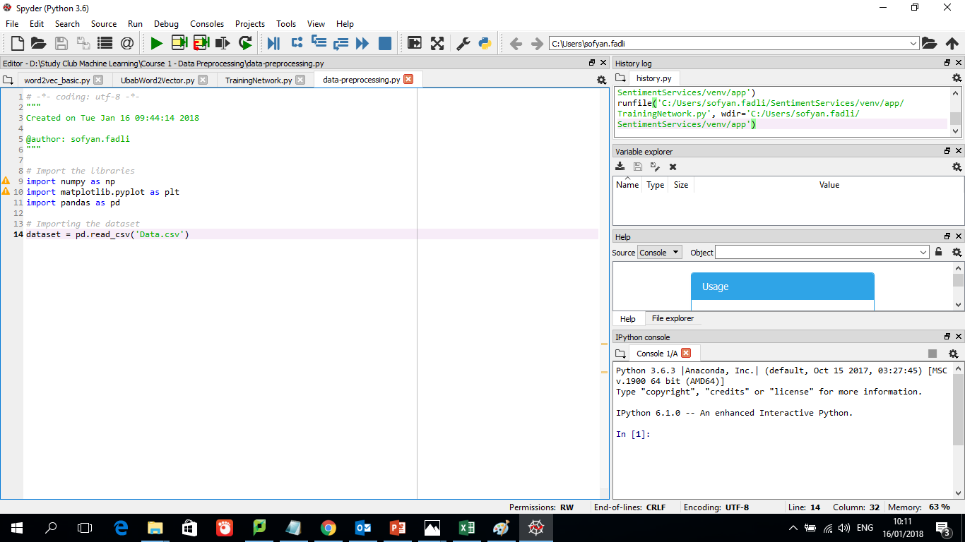
Set Working Directory

Slide 18
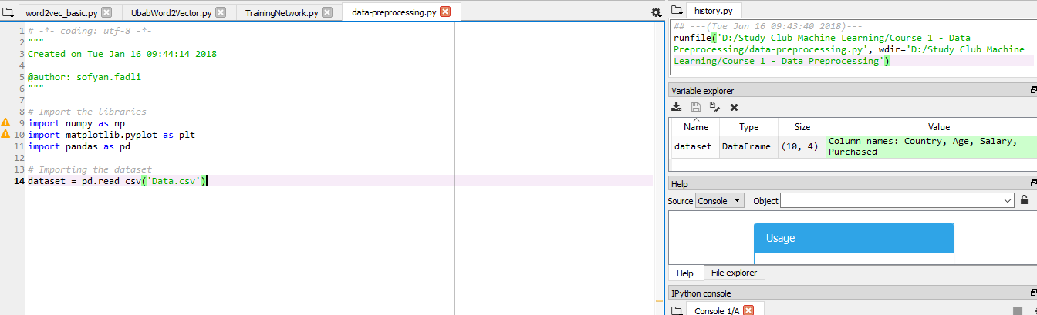
Import the dataset

Slide 19
Import the dataset
Klik disini

Slide 20
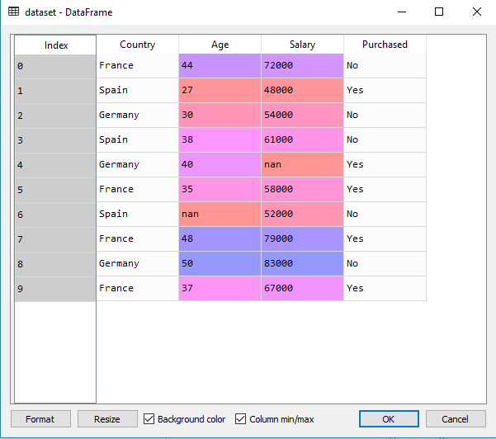

Slide 21
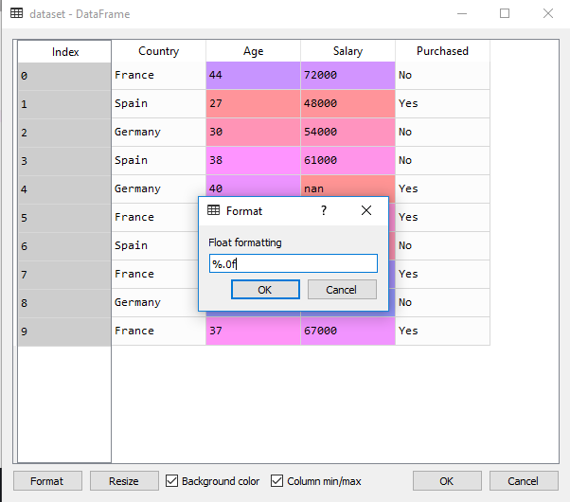
Change format data to %.0f

Slide 22
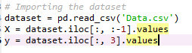
Get Matrix Features

Slide 23
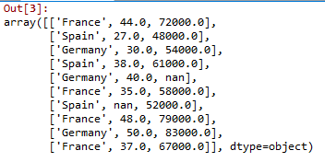
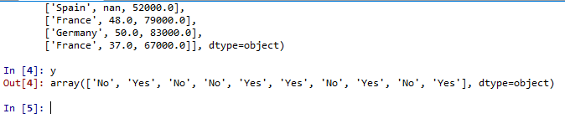
X
y

Slide 24
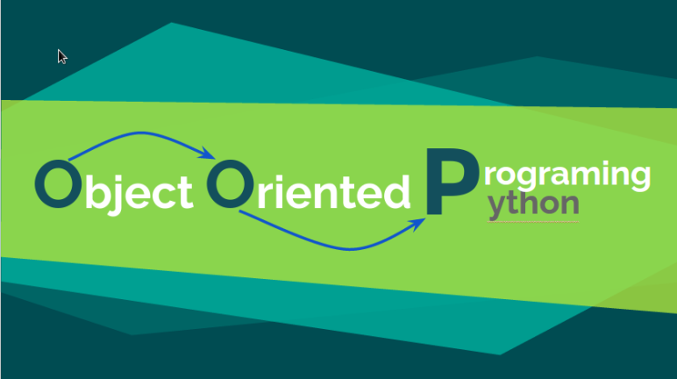
Object-oriented programming: classes & objects

Slide 25

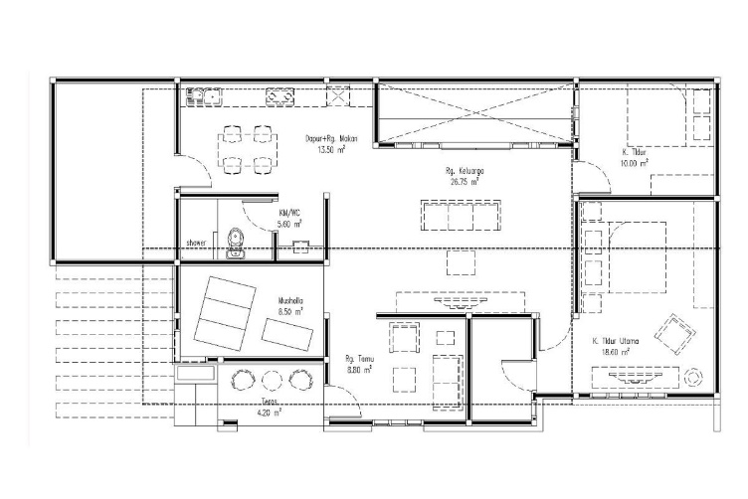

- A class is the model of something we want to build
- An object is an instance of the class.
- A method is a tool we can use on the object to complete a specific action.
Class
Object
Methods

Slide 26
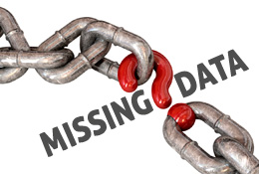
Fix Missing Data

Slide 27
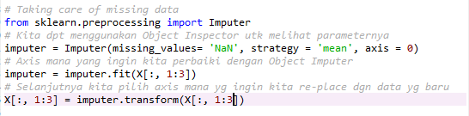

Slide 28
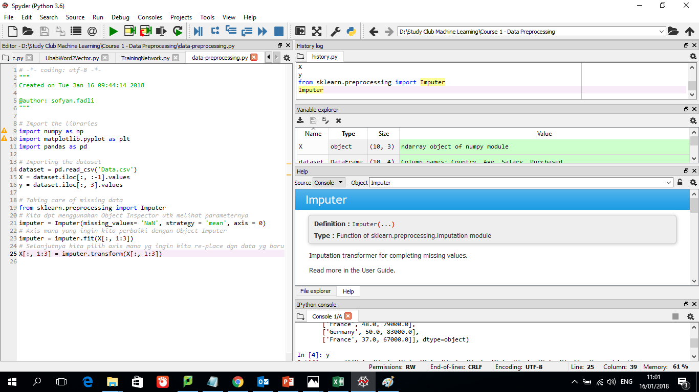

Slide 29
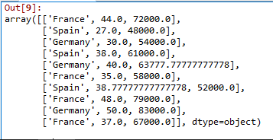
Hasil setelah code di-run :

Slide 30
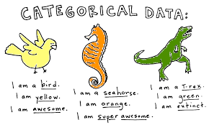
Categorical Data

Slide 31
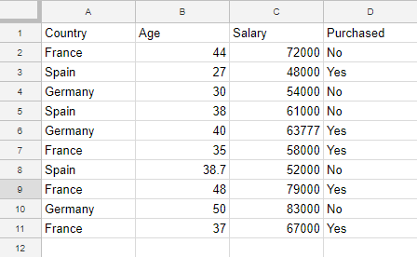
Categorical Data

Slide 32
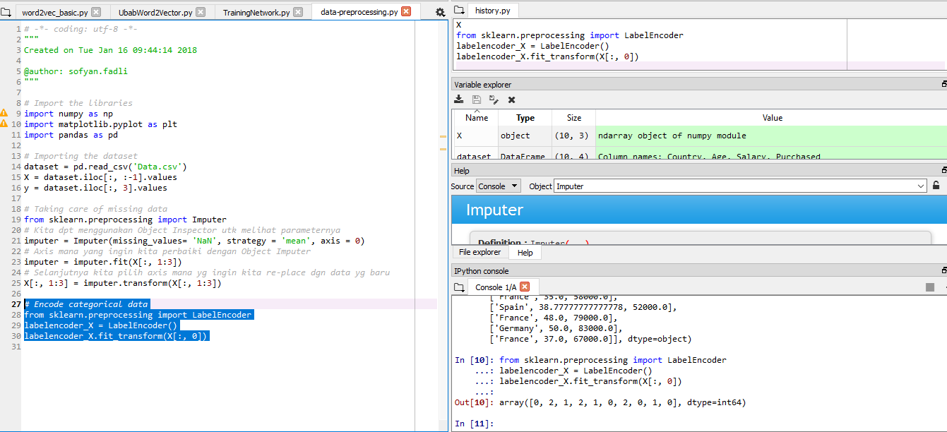

Slide 33
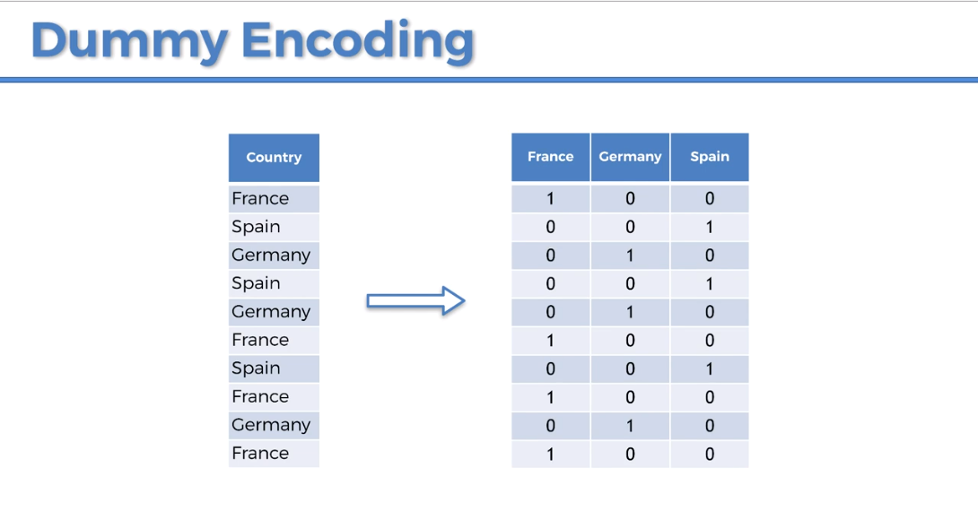

Slide 34
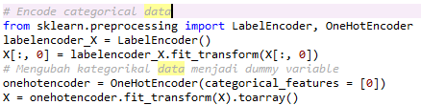

Slide 35
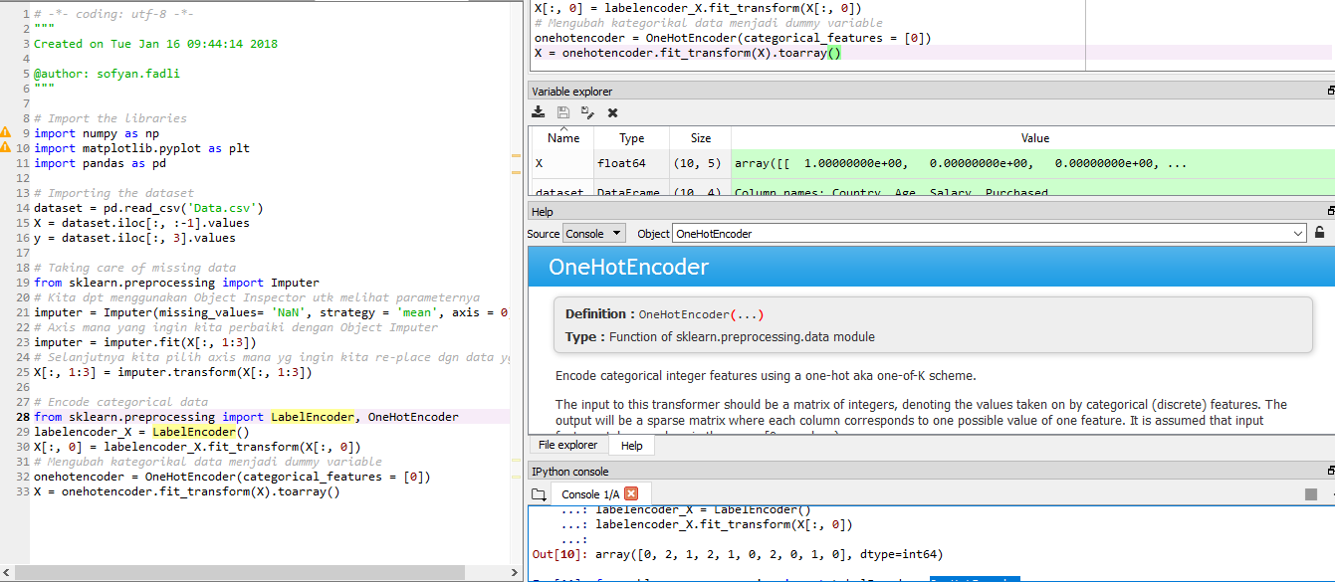

Slide 36
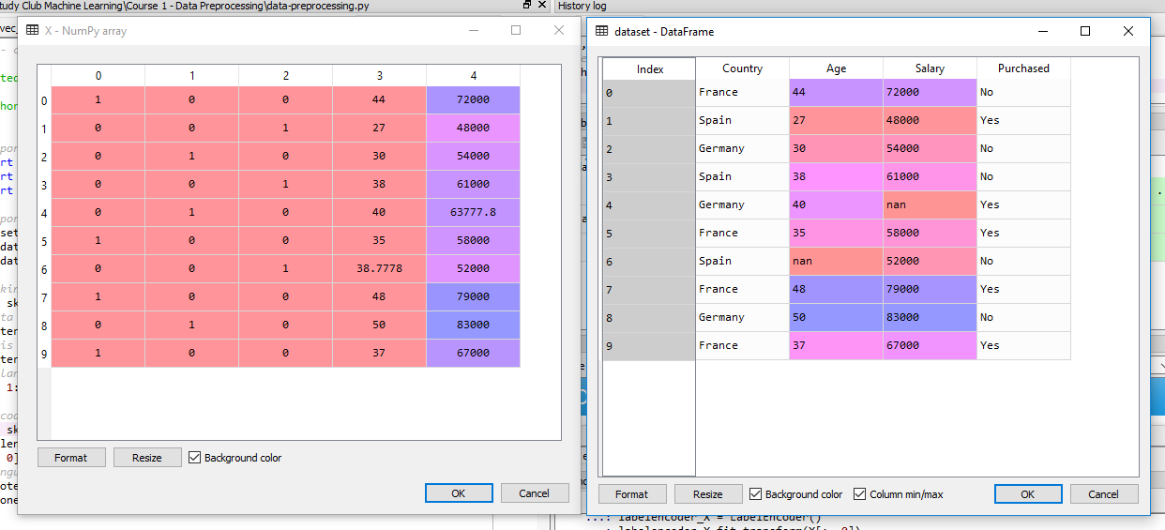

Slide 37
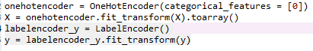

Slide 38
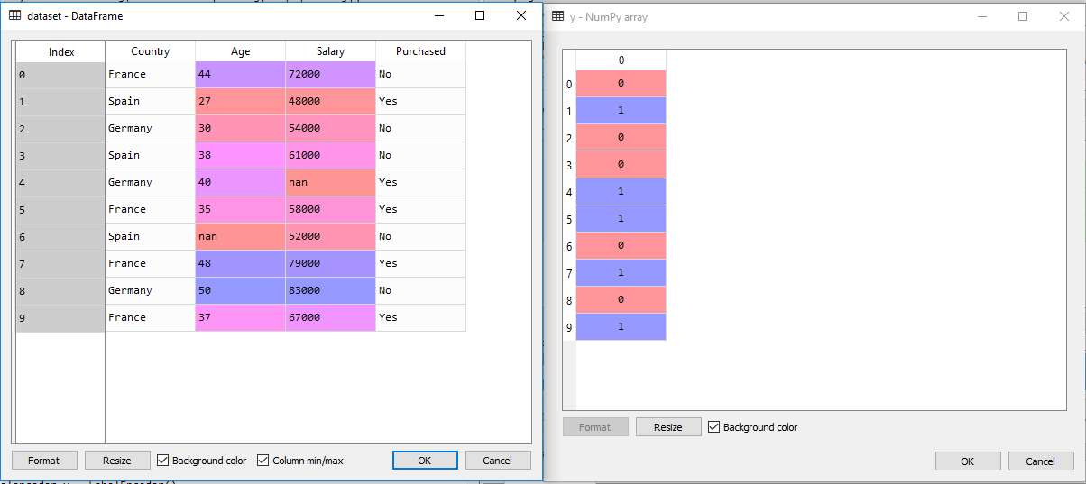

Slide 39
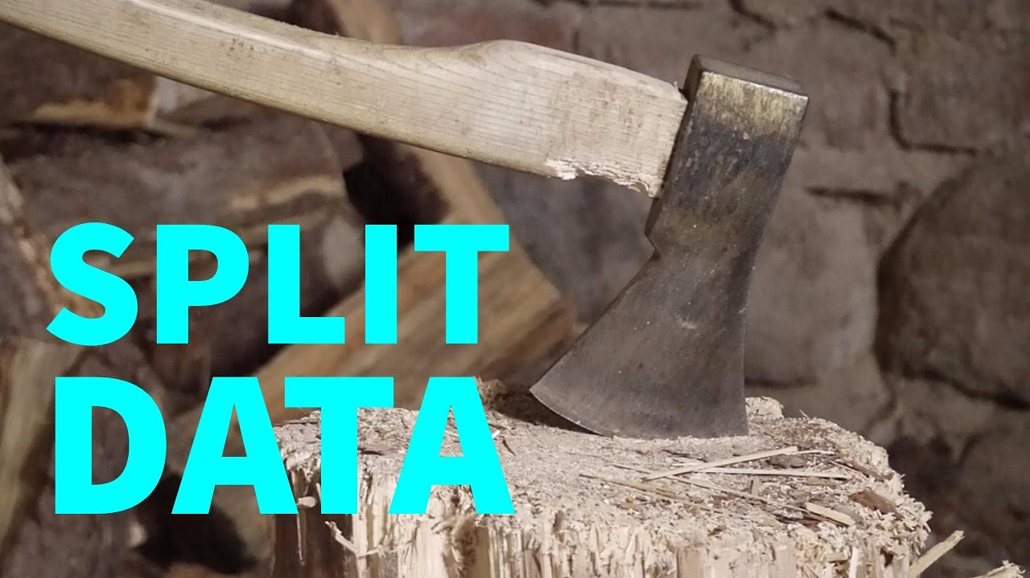
Splitting Training & Testing Dataset

Slide 40
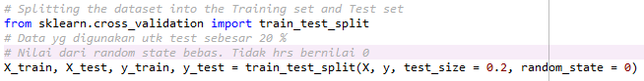

Slide 41
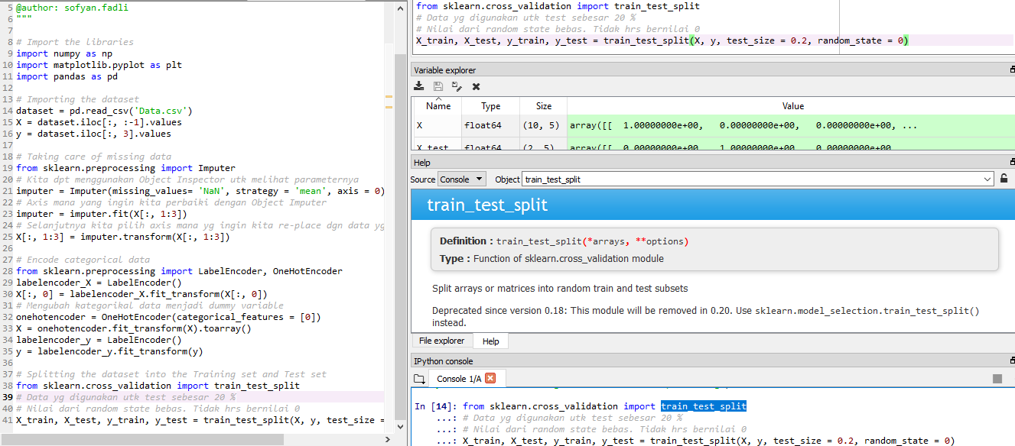

Slide 42
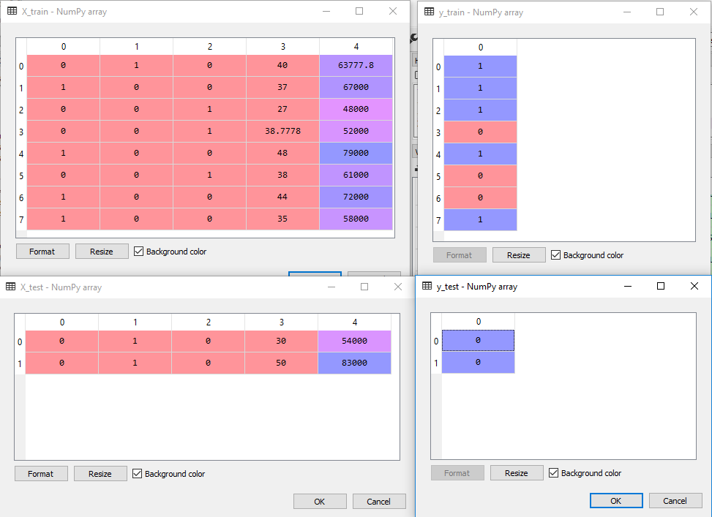

Slide 43
Catatan :
Semakin banyak korelasi antar independent variable, kadang itu membuat pemodelan machine learning menjadi bingung untuk menentukan korelasi antar variable. Hal ini dinamakan dengan overfitting

Slide 44
Feature Scaling

Slide 45
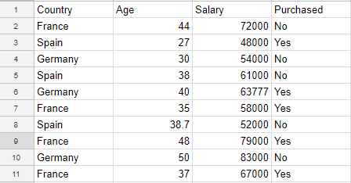
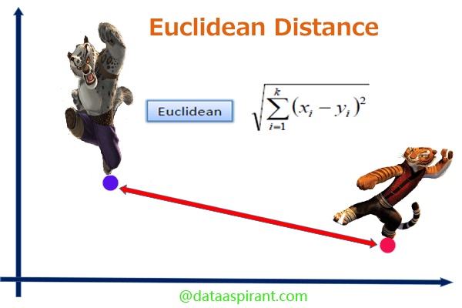
Machine learning model is based on Euclidian Distance

Slide 46
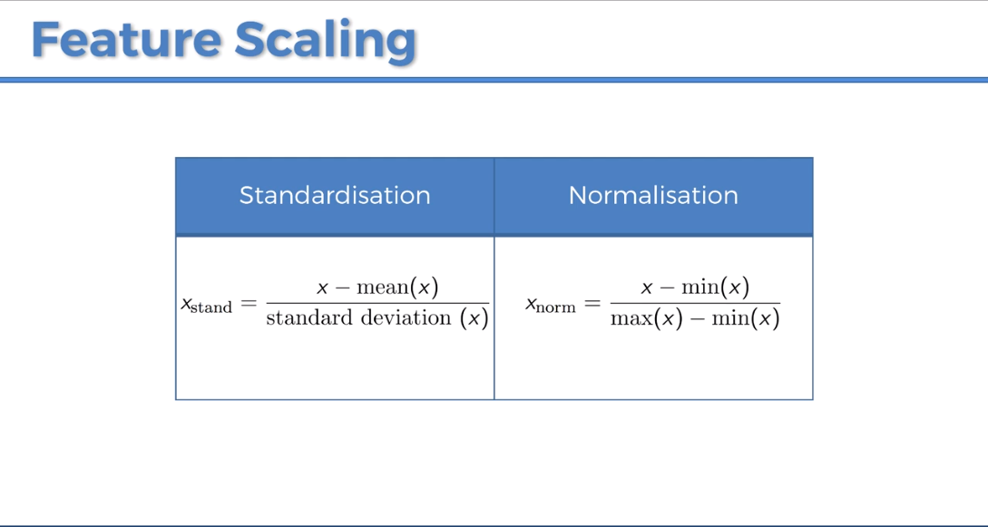

Slide 47
Commonly Ask Question :
Apakah kita perlu menscalling dummy variable ???
Answer :
Tergantung kebutuhan. Menscalling seluruh independent variable akan baik karena dapat meningkatkan accuracy prediction. Tetapi jika kita tidak menscalling dummy variabl, sebenarnya tidak terlalu berpengaruh juga terhadap model Machine Learning

Slide 48
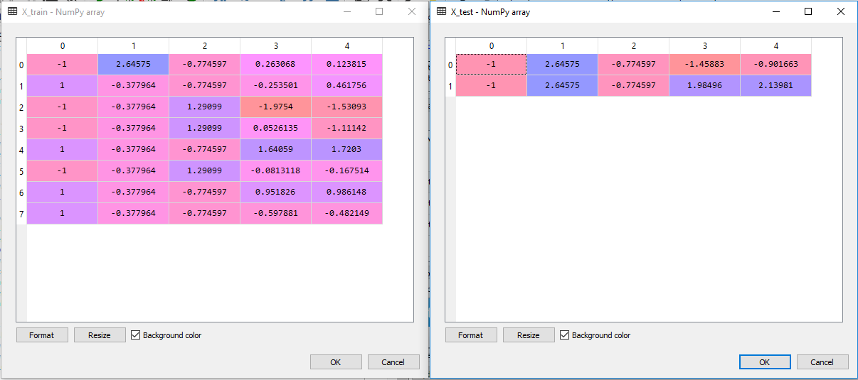

Slide 49
Commonly Ask Question :
Apakah kita perlu menscalling dependent variable ???
Answer :
Tergantung jenis model ML yang akan kita buat. Jika model ML-nya Regresi, maka kita perlu melakukan scalling pada dependent variable. Jika model ML-nya Klasifikasi, kita tidak perlu melakukannya.

Slide 50
Template Data Preprocessing

Slide 51
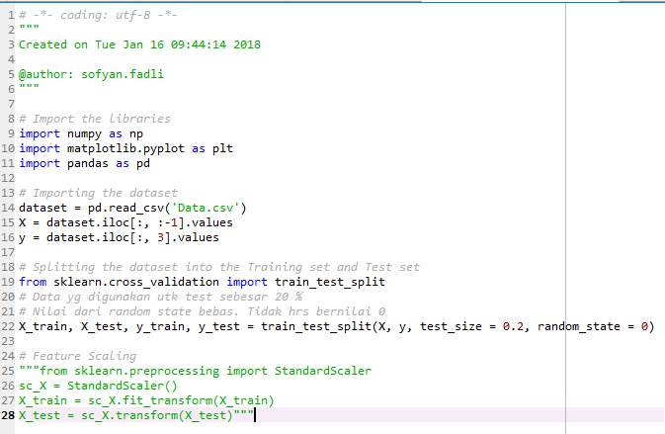

Slide 52
Start
A
Get Dataset
Manage Categorical Data
Import Libraries
Splitting Dataset
Import Dataset
Feature Scaling
Correct Missing data
Data Preprocessing Template
A
END

